Slide 1



Chapter 37
CBA 2: A LIFE IN TIME
cba 2: a life in time
@MsDoorley

Slide 2
Learning Outcomes
2.11 MAKE CONNECTIONS between local, personal or family history and wider national and/ or international personalities, issues and events.
1.1 DEVELOP a sense of historical empathy by viewing people, issues and events encountered in their study of the past in their historical context.
1.2 CONSIDER contentious or controversial issues in history from more than one perspective and DISCUSS the historical roots of a contentious or controversial issue or theme in the contemporary world.
1.3 APPRECIATE their cultural inheritance through recognising historically significant places and buildings and DISCUSSING why historical personalities, events and issues are commemorated.
1.4 DEMONSTRATE awareness of historical concepts, such as source and evidence; fact and opinion; viewpoint and objectivity; cause and consequence; change and continuity; time and space.
1.5 INVESTIGATE the job of the historian, including how s/he finds and uses evidence to form historical judgements which may be revised and reinterpreted in the light of new evidence.
1.6 DEBATE the usefulness and limitations of different types of primary and secondary sources of historical evidence, such as written, visual, aural, oral and tactile evidence; and APPRECIATE the contribution of archaeology and new technology to historical enquiry.
1.7 DEVELOP historical judgements based on evidence about personalities, issues and events in the past, showing awareness of historical significance.
1.8 INVESTIGATE a repository of historical evidence such as a museum, library, heritage centre, digital or other archive or exhibition.
1.9 DEMONSTRATE awareness of the significance of the history of Ireland and of Europe and the wider world across various dimensions, including political, social, economic, religious, cultural and scientific dimensions.
1.10 DEMONSTRATE chronological awareness by creating and maintaining timelines to locate personalities, issues and events in their appropriate historical eras.
1.11 MAKE CONNECTIONS AND COMPARISONS between people, issues and events in different places and historical eras.
Strand One: The Nature of History
Chapter One: The Historian
@MsDoorley

Slide 3
What is CBA 2?
  CBA 2 takes place in Third Year.
  CBA 2 is a written record – for example, a news article, an essay, a blog, a script for a podcast, a letter to a journal or newspaper, an obituary, a speech, etc.
  For CBA 2, you will be researching the life of a person in history. You can look at the life of anyone who has made a significant contribution to history, giving you the freedom to research the life of someone you are interested in from a part of history you like.
Strand One: The Nature of History
CBA 2: A Life In Time
@MsDoorley

Slide 4
A Life In Time
  In this CBA, you will be researching the life of a person in history.
  You can look at the life of anyone who has made a significant contribution to human history.
  This gives you great freedom to research the life of someone that you are interested in from a part of history you like. It does not have to be someone you have looked at in class, nor do they have to be from a topic you have studied as part of the Junior Cycle.
Remember: if you did an Irish history topic in CBA 1, you have to look at someone from outside Ireland in CBA 2 – and vice versa.
  When you have picked someone to write about, you need to consider how you are going to approach writing about their life.
  This CBA is not designed to be a summary of the person’s life such as you would find on the internet.
  Instead, you are expected to focus on, and write in detail, an aspect of the person’s life. For example, you could:
    Look at their contribution to some significant historical change
    Look at an aspect of their life or career
    Look at their influences or important relationship in their life
Strand One: The Nature of History
CBA 2: A Life In Time
@MsDoorley

Slide 5
Possible themes or subjects for research
  CBA 2 takes place in Third Year.
  CBA 2 is a written record – for example, a news article, an essay, a blog, a script for a podcast, a letter to a journal or newspaper, an obituary, a speech, etc.
  For CBA 2, you will be researching the life of a person in history. You can look at the life of anyone who has made a significant contribution to history, giving you the freedom to research the life of someone you are interested in from a part of history you like.
Strand One: The Nature of History
CBA 2: A Life In Time
@MsDoorley

Slide 6
Selecting your topic
Five Rs for thinking about historical significance
Remarkable – the event or development was remarked upon by people at the time and/or since
Remembered – the event or development was important at some stage in history within the collective memory of a group or groups.
Resonant – people life to make analogies with it; it is possible to connect with experiences, beliefs or situations across time and space.
Resulting in change – it had consequences.
Revealing – of some other aspect of the past.
Strand One: The Nature of History
CBA 2: A Life In Time
@MsDoorley

Slide 7
Selecting your topic
  There are a few things to consider, when deciding your CBA 2 topic:
    Are you interested in the topic?
    Can you get more than one good source for this topic?
    Can you gather a lot of information about your topic?
    Does your topic connect to the history of Ireland and/or the wider world?
Strand One: The Nature of History
CBA 2: A Life In Time
@MsDoorley

Slide 8
Sources
  Once you have selected your topic, you then need to identify your sources for the CBA. The sources used mist be cited in a bibliography at the end of the CBA. You should try to get at least two different sources (for example, a book (written) and a documentary (visual)).
  When finding sources, ask yourself what question you are trying to answer and consider what question you are trying to answer and consider what source might be suitable.
  For example:
    If you are researching what life looked like during a certain time, photographs give great visual detail.
    If you are looking into local placenames, old maps would be useful.
    If you are looking into family history, interviewing a family member would be useful.
    You must be careful to make sure your information is reliable and that you have cross-checked it with another source.
Strand One: The Nature of History
CBA 2: A Life In Time
@MsDoorley

Slide 9
Bibliography
  A bibliography is a list of all the sources you used, whether you referenced them directly or not, when carrying out research. https://educateplus.ie/go/harvard-guide
Source Type | In-Text Citation | Bibliography
Book | (Ferriter, 2005, p. XX) | Ferriter, D. (2005) The Transformation of Ireland 1900 – 2000. London: Profile Books.
Newspaper Article | (O'Shannon, 1963) | O’Shannon, C. (1963). ‘President visits a divided Berlin’, The Irish Times, 27 June, p. 1.
Online article | (McCaffrey, 2004, p. XX) | McCaffrey, L. (2004) ‘Ireland and Irish America: Connections and Disconnections’, U.S. Catholic Historian vol. 22, no. 3 [online]. Available at https://www.jstor.org/stable/25254917 (accessed 07/11/2021)
Online film/ documentary | (Century Ireland, 2013) | The Battle for Suffrage (2013). Century Ireland [Documentary film] Available at: https://www.youtube.com/watch?v=kRGKdmbYgYI&t=1s (accessed: 07/11/2021)
Strand One: The Nature of History
CBA 2: A Life In Time
@MsDoorley

Slide 10
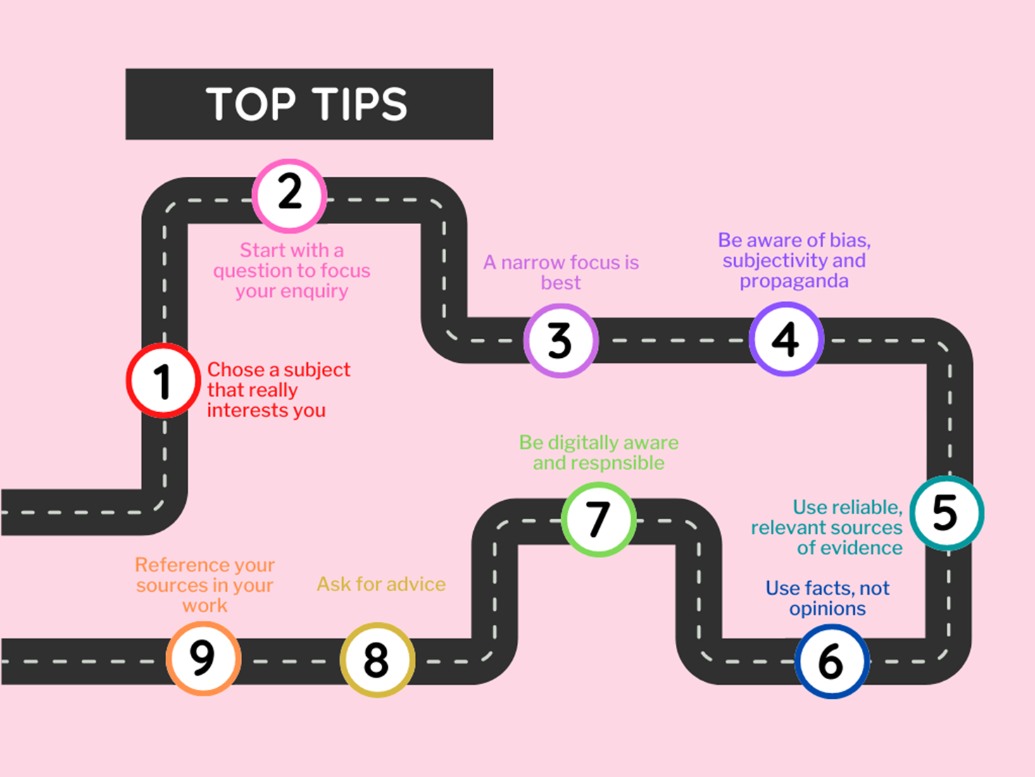
Strand One: The Nature of History
CBA 2: A Life In Time
@MsDoorley

Slide 11
Writing up your research
  When you have finished your research, you will then write up your findings and present them in the form of a written record.
  Your written record may be presented as:
    A news article, an essay, a blog, a script for a podcast, a letter to a journal or newspaper, an obituary, a speech, etc.
Strand One: The Nature of History
CBA 2: A Life In Time
@MsDoorley

Slide 12
Success Criteria
  When you have finished your research, you will then write up your findings and present them in the form of a written record.
  Your written record may be presented as:
    A news article, an essay, a blog, a script for a podcast, a letter to a journal or newspaper, an obituary, a speech, etc.
Strand One: The Nature of History
CBA 2: A Life In Time
@MsDoorley

